Slide 1
SoundMedicine: A Portable, Smartphone-Based Pneumonia Diagnostic Device
Ross Agen, Andrue Caruso, Andrew Stoycos, Nick Thomas
Iosif M Gershteyn, Andrey Vyshedskiy
04/27/2018
Notes:
Stoycos

Slide 2
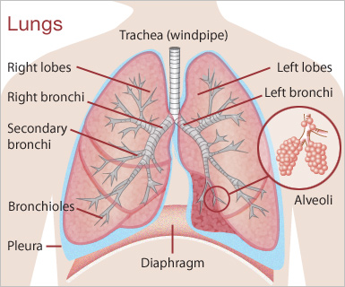

Major Problem: Pneumonia
Lung Infection
fluid in lungs
200 million viral cases annually
100 million in children
100 million in adults
Responsible for deaths in developed and developing countries
16% all deaths - children under 5
largest cause of child death worldwide
significant effect on elderly (65+)
http://sathitamai.wixsite.com/visualartseportfolio/single-post/2016/03/06/Q3-Unit-3-Research-of-the-Human-Lungs
Ruuskanen, Olli. “Viral Pneumonia.” ScienceDirect. 22 March 2011. Web. Accessed 15 October 2017.
“Pneumonia.” World Health Organization. September 2016. Web. Accessed October 15 2017.
Dadlani, Pavan. “Supporting the Diagnosis of Childhood Pneumonia in Low Resource Settings.”Healthcare Engineering. 29 November 2016. Web. Accessed 17 November 2010.
"World Pneumonia Day 2015 Infographic." UNICEF DATA. January 16, 2017. Accessed October 16, 2017. https://data.unicef.org/resources/world-pneumonia-day-2015-infographic/.
Notes:
Stoycos

Slide 3
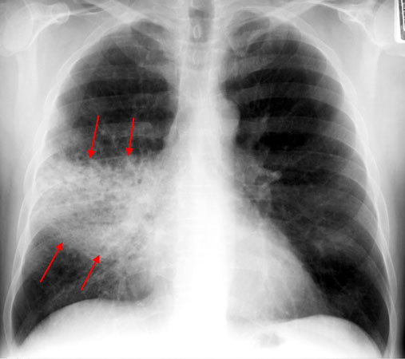
Major Problem: Pneumonia
Preventable and treatable but…
Expensive diagnosis
Often mistaken for the common cold
Low resource, developing countries have:
limited access to preventative measures (vaccines, etc.)
limited access to treatment
https://www.med-ed.virginia.edu/courses/rad/cxr/pathology3chest.html
Ruuskanen, Olli. “Viral Pneumonia.” ScienceDirect. 22 March 2011. Web. Accessed 15 October 2017.
“Pneumonia.” World Health Organization. September 2016. Web. Accessed October 15 2017.
Dadlani, Pavan. “Supporting the Diagnosis of Childhood Pneumonia in Low Resource Settings.”Healthcare Engineering. 29 November 2016. Web. Accessed 17 November 2017.
Notes:
Stoycos
30% of cases were not caught my a physical exam

Slide 4
Aims
Aim 1: Design and build a Sound capturing module
Aim 2: Develop an application to process auditory information and display results/recommendations
Aim 3: Incorporate a method of delivering diagnostic information to a physician
Notes:
Ross

Slide 5
Particular Problem:
Accessibility and Affordability
Standard procedure includes
X-Rays, doctor visits, etc.
Expensive
Requires a lot of maintenance and training
Decreases accessibility for proper diagnosis and treatment
Drives up mortality rate
Solution: affordable, portable diagnostic
Takes advantage of current/popular technology
Notes:
Ross

Slide 6
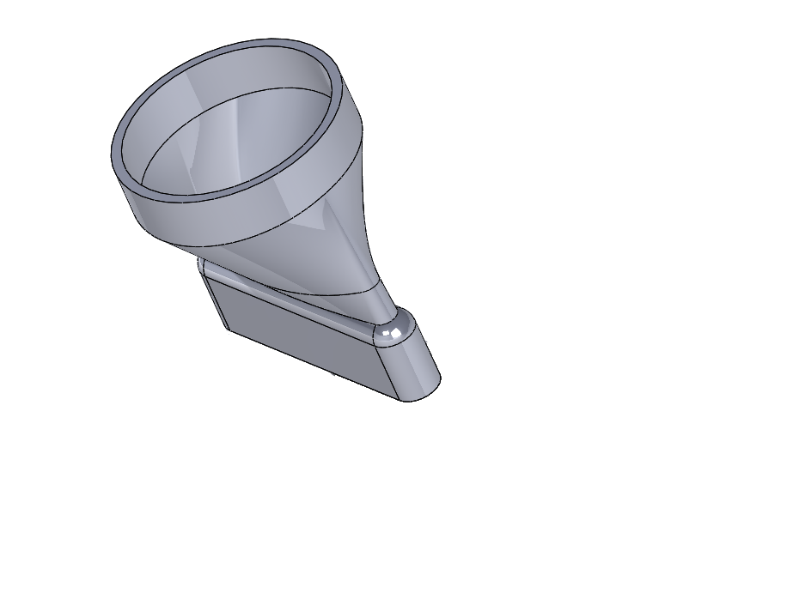
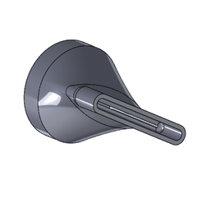
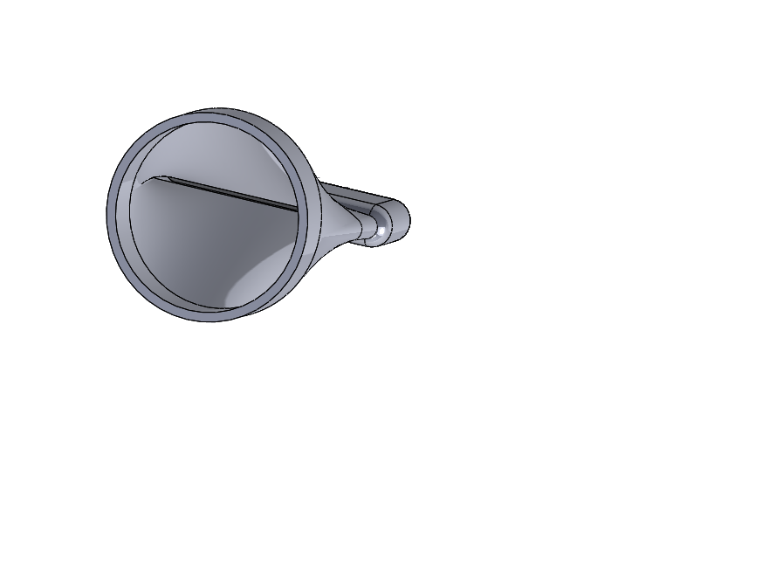
Approach: Sound Capturing Module
Research phone popularity & specs (dimensions, microphone location)
Create designs - CAD
Prototype/Test designs, materials
3D Printing
Contact manufacturers
Notes:
Andrue

Slide 7
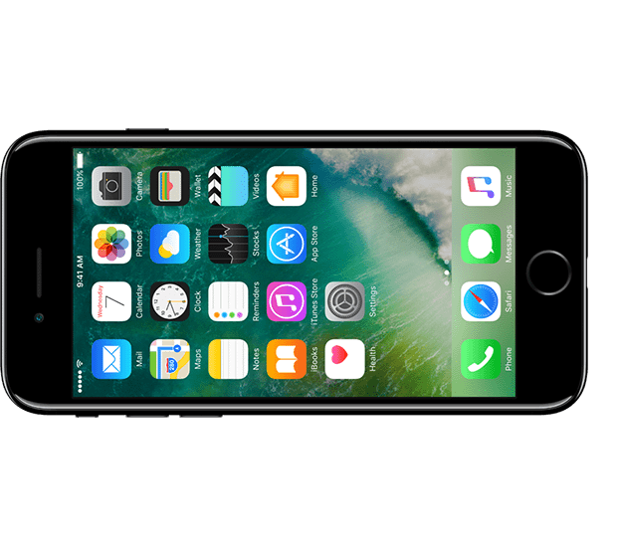
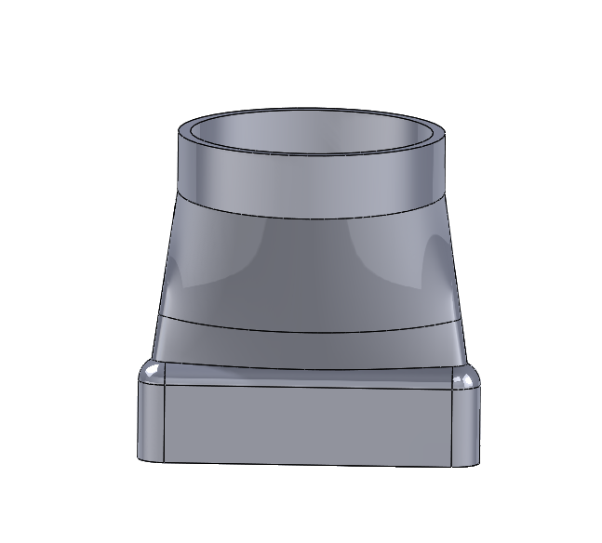
Functional Requirements
The Sound Capturing Module
Adaptable to multiple smartphones
Acquire lung sounds ranging from 60 Hz - 2,000 Hz
Elastic and durable material
Inexpensive to manufacture
High Signal to Noise Ratio
Notes:
Andrue

Slide 8
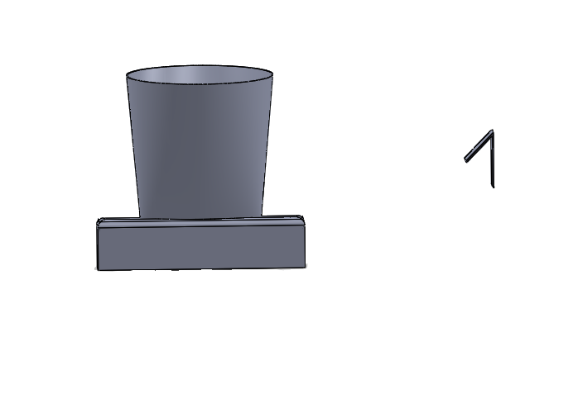
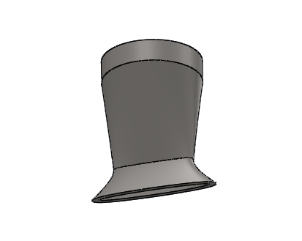
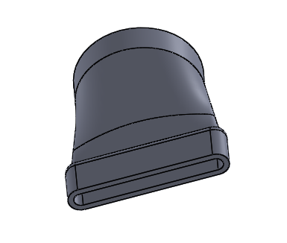
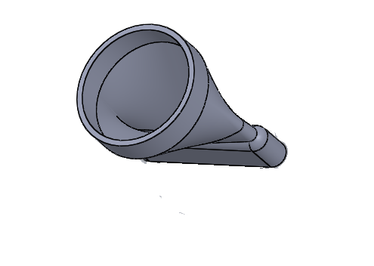
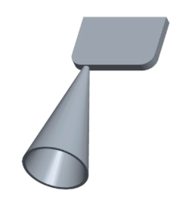
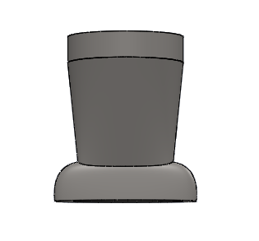
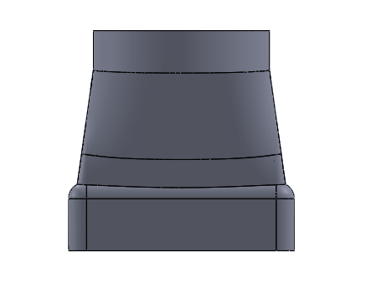
Evolution of Prototype
Notes:
Andrue and Ross

Slide 9

Approach: Smartphone Application
Develop code for sound processing and packaging
Develop user interface to instruct user, display results/data
Send data with a provided email
Notes:
Nick

Slide 10
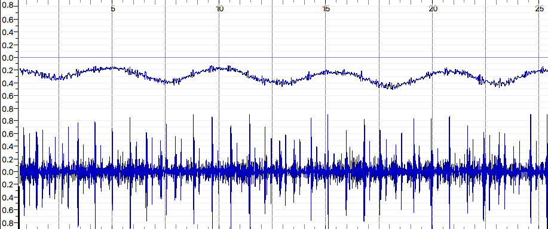
Functional Requirements
The Application
Four main functions:
Record accelerometer and audio data
Filter the audio data to reduce noise
Package all the data into a single wav-file
Email collected data
Image created using Sonic Visualizer (app)
Notes:
Nick

Slide 11
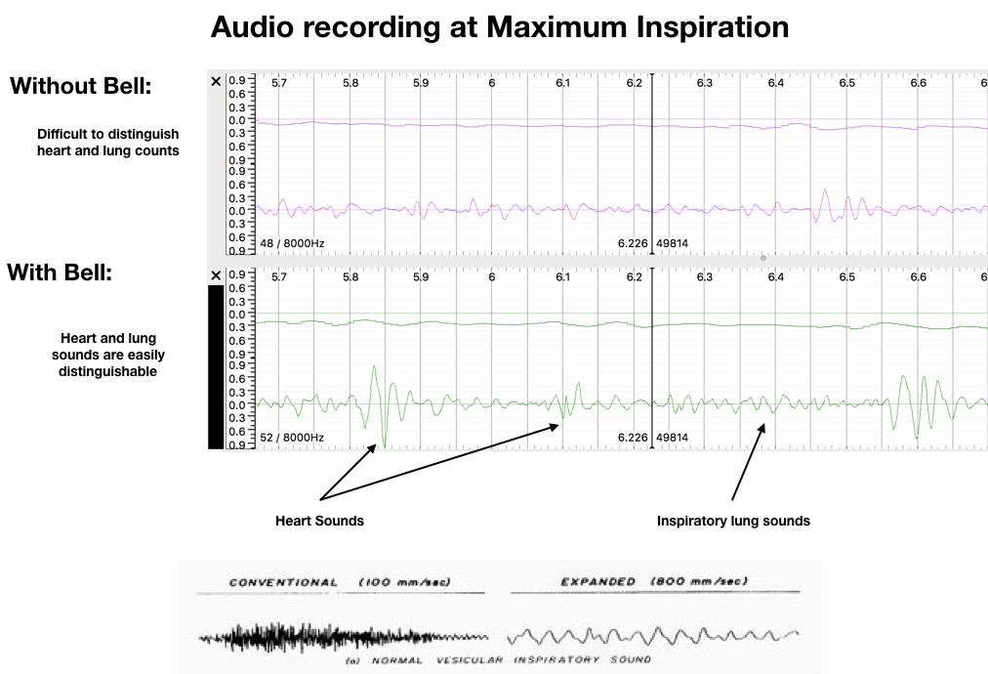
images from, sonic visualizer (app), stethographics.com
Notes:
Andrew (accelerometer) and Ross (signal to noise)

Slide 12
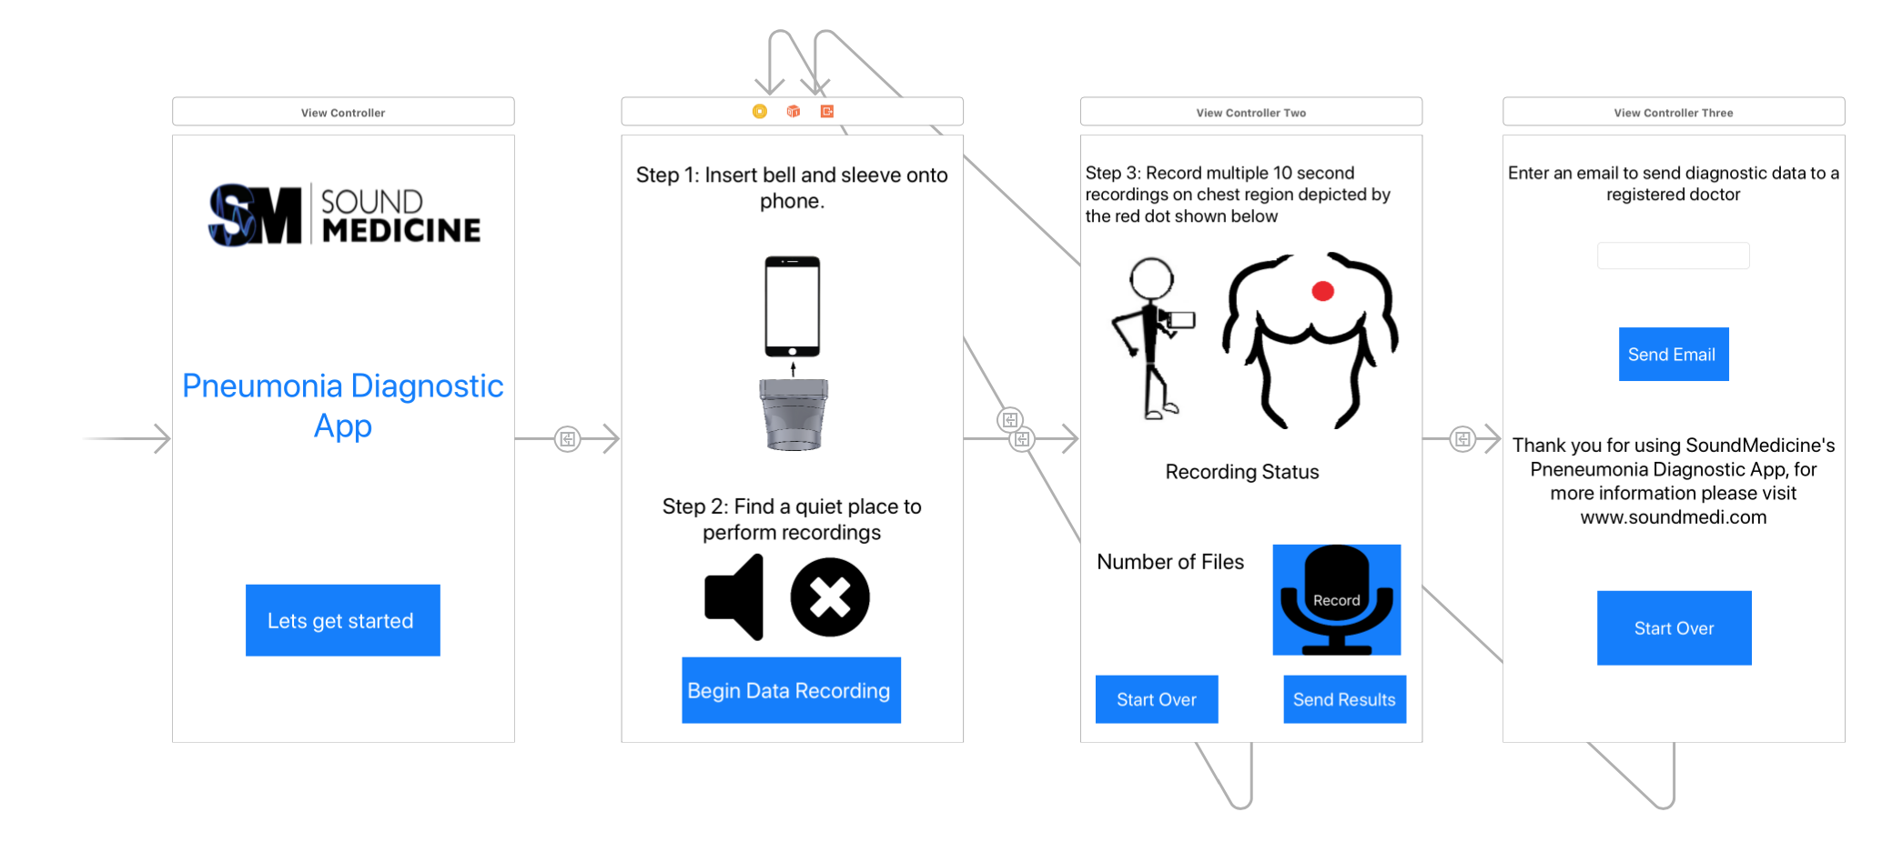
User Interface
Notes:
Andrew

Slide 13


